Slide 1
Income Predication Using Different sets of Algorithm
By : Akhilesh Mishra

Slide 2
Introduction
About Dataset
The dataset contains information about the annual incomes of people from 41 different countries, but the majority (90%) is dominated by the United States. The runner-up in this category is Mexico at 2%, leaving only 8% for the other 40 countries.
Object
To predict whether a person earns more than $50k per annum or not.

Slide 3
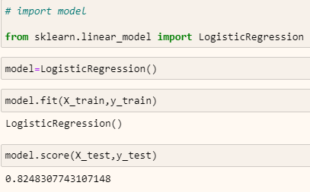
Algorithms
Logistic Algorithm
Logistic regression is a statistical analysis method used to predict a data value based on prior observation of a data set.
It is used for estimating the parameters which gives better result means unbiased with lower variance.

Slide 4
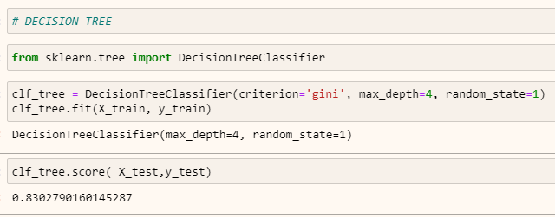
Decision Tree Decision tree analysis involves making a tree-shaped diagram to chart out a course of action or a statistical probability analysis

Slide 5
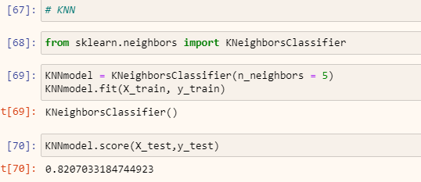
KNN One of the simplest classification algorithm and it is one of the most used learning algorithm which is non parametric , lazy learning algorithm. A k-nearest-neighbor is a data classification algorithm that attempts to determine what group a data point is in by looking at the data points around it.

Slide 6
Summary
Decision Tree gives maximum accuracy --- 83.82%.
Logistic gives accuracy 82.48%
KNN gives accuracy ----82.07%

Slide 7
THANK YOU

